Slide 1

University Galleries Sculpture WebMap
Project Team: Erik Martinez Luna, Jose Silva, Kate Merlock, Binsheng Xu

Slide 2
Project Outline
Create a web map that contains art sculptures locations on campus
Customer
Jayne Hattaway, University Art Galleries, Communication Specialist

Slide 3
Deliverable
Web page code will be the delivered product
Web map contains
Points with info windows
Descriptions of all art statues
Customer will learn to manipulate code for project sustainability

Slide 4
Project Establishment and Development
Collect sculpture locations
Google Maps API
Automate creation of markers
Automate creation and populate infowindows with sculpture information and picture
Drop down menu
Show list of sculptures and pan to selected

Slide 5
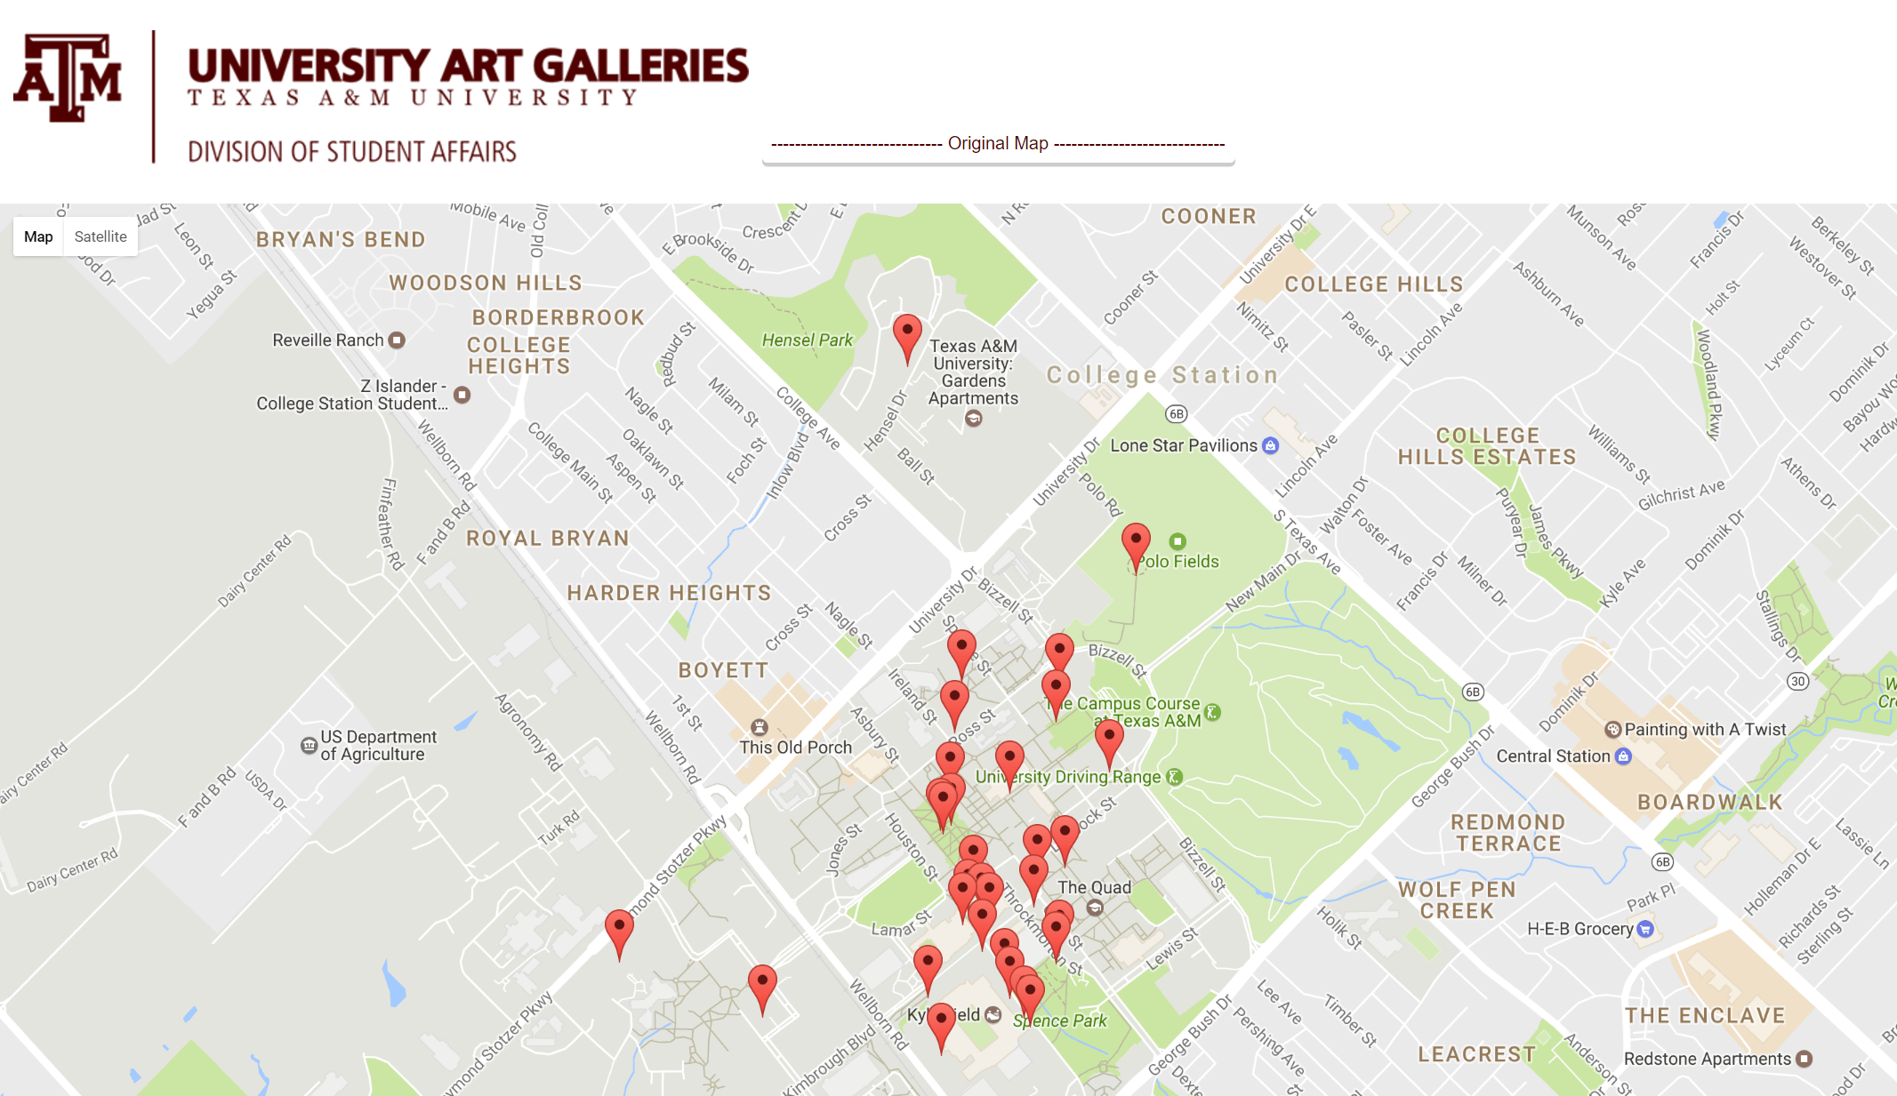
Final Product

Slide 6
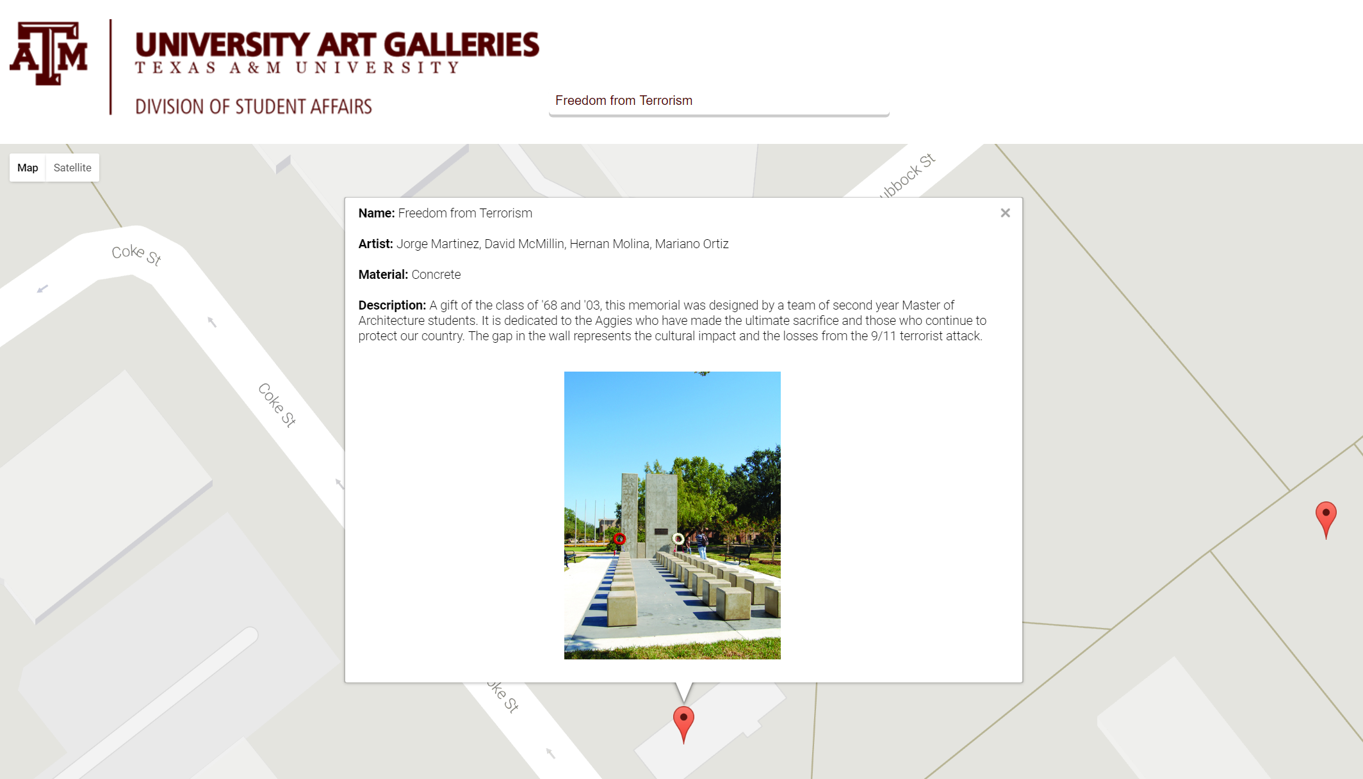

Slide 7

Thank you
Questions?
erik.martinez.luna@tamu.edu

